Slide 1
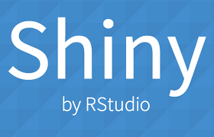
Developing Data Product

Slide 2
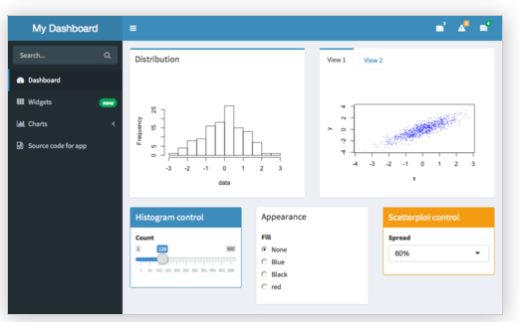
What is Shiny?
Shiny is an open source R package that provides an elegant and powerful web framework for building web applications using R.
You can host standalone apps on a webpage or embed them in R Markdown documents or build dashboards.
You can also extend your Shiny apps with CSS themes, htmlwidgets, and JavaScript actions.
https://shiny.rstudio.com/

Slide 3
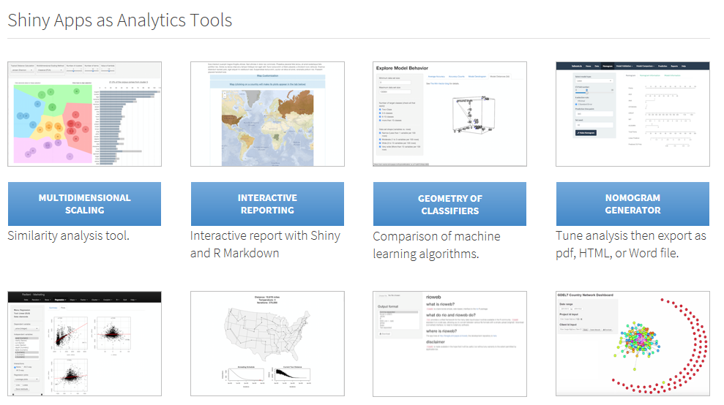
Shiny Show Case
https://www.rstudio.com/products/shiny/shiny-user-showcase/

Slide 4
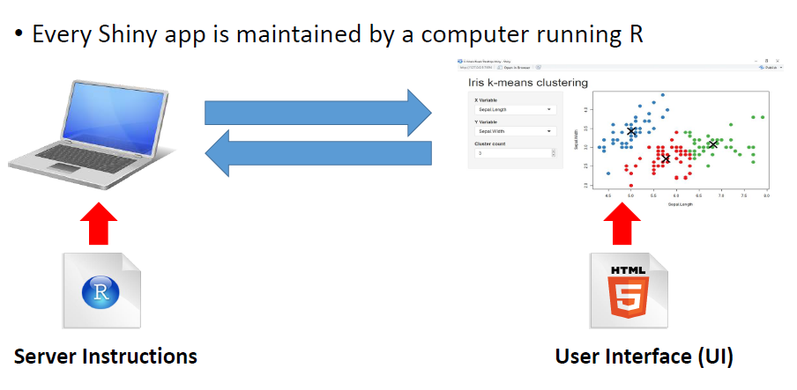
The Architecture of Shiny

Slide 5
Shinyapps.io
Shinyapps.io is a platform as a service (PaaS) for hosting Shiny web apps (applications).
Before you get started with shinyapps.io, you will need:
An R development environment, such as the Rstudio IDE
(for Windows users only) Rtools for building packages
(for Mac users only) Xcode Command Line Tools for building packages
(for Linux users only) GCC
The devtools R package (version 1.4 or later)
The latest version of the rsconnect R package

Slide 6
Installation of devtools and rsconnect
devtools
Shinyapps.io uses the latest improvements to the devtools package. To use shinyapps.io, you must update devtools to version 1.4 or later. To install devtools from CRAN, run the code below. Then restart your R session.
> install.packages('devtools')
rsconnect
The rsconnect package deploys applications to the shinyapps.io service. Currently, you need to install the rsconnect package from its development page at Github. You can do this by running the R command:
> devtools::install_github('rstudio/rsconnect')
After the rsconnect package has been installed, load it into your R session:
> library(rsconnect)

Slide 7
Shinyapps Package
Installation of shinyapps package:
To install directly from GitHub, run this:
if ( !require ("devtools"))
install.packages ("devtools")
devtools::install_github ("rstudio/shinyapps")

Slide 8
Create a shinyapps.io Account
Go to shinyapps.io and click “Log In.”
If you do not have an account, create a new account or sign in using your Google or github account
The first time you sign in, shinyapps.io prompts you to setup your account. Shinyapps.io uses the account name as the domain name for all your apps.
Once you set up your account in shinyapps.io, you can configure the rsconnect package to use your account.

Slide 9
Configure the rsconnect Package
Click the show button on the token page.
Copy the command to your clip board, and then paste it into the command line of Rstudio and click enter.
Refer to: https://shiny.rstudio.com/articles/shinyapps.html

Slide 10
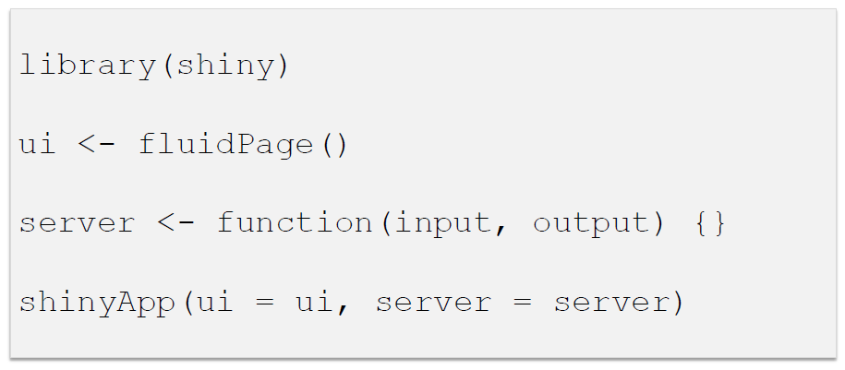
App template

Slide 11
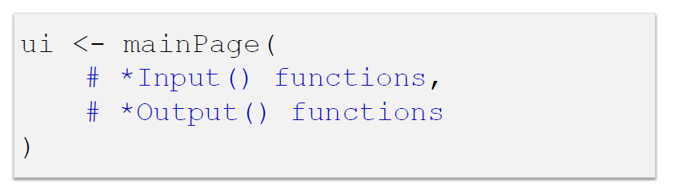
Input and Output
Add elements to your app as arguments to mainPage( )

Slide 12
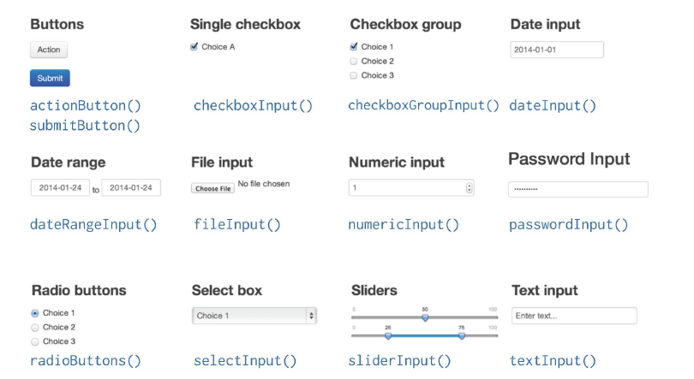
Input

Slide 13
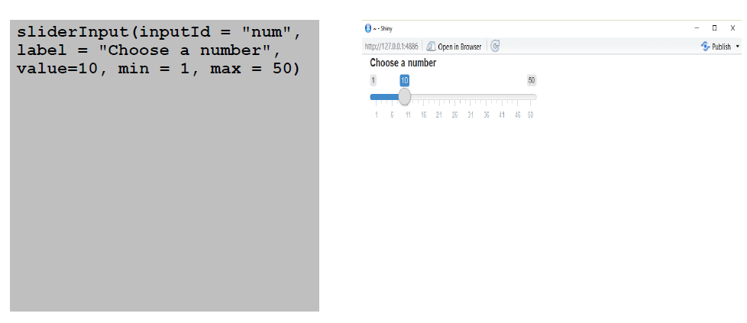
Create an Input with an Input() function

Slide 14
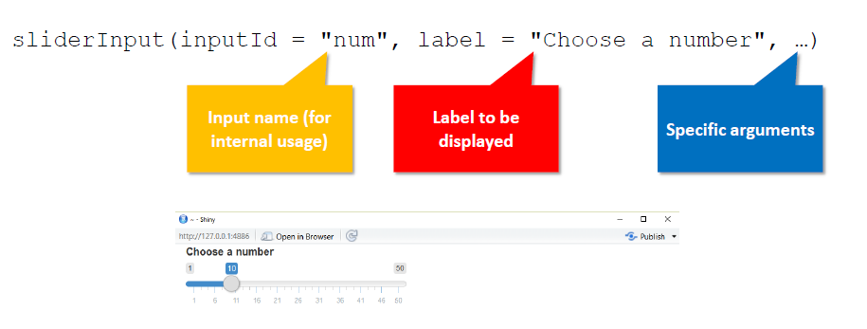
Input Syntax

Slide 15
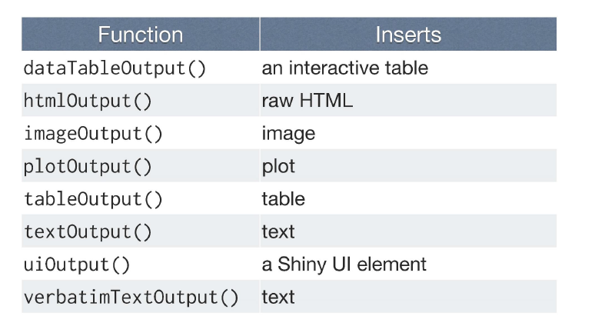
Output

Slide 16
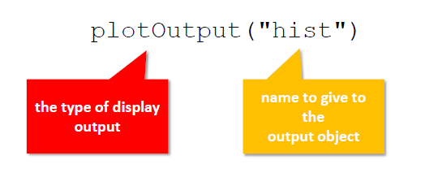
Output Syntax
To display output, add it to fluidPage() with an *Output() function

Slide 17
Server Function
Use 3 rules to write the server function
Save objects to display to output$
Build objects to display with render*()
Access input values with input$
Reactivity automatically occurs whenever you use an input value to render an output object

Slide 18
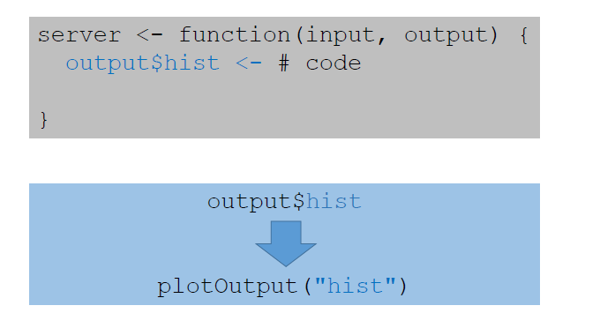
Server Function
Save objects to display to output$

Slide 19
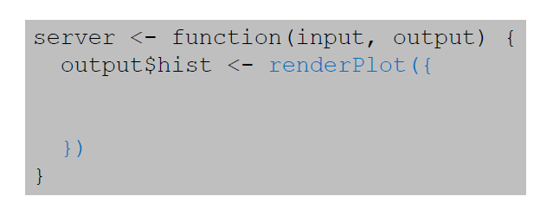
Server Function
Build objects to display with render*()

Slide 20
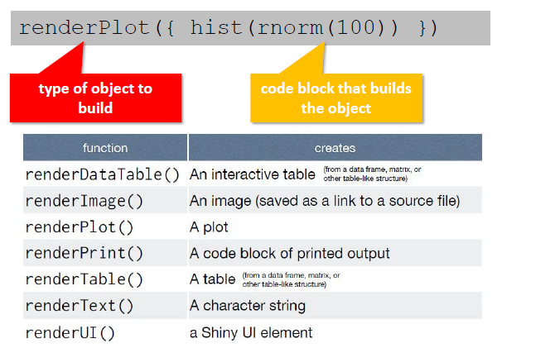
Render Function
Use the render*() function that creates the type of output you wish to make.

Slide 21
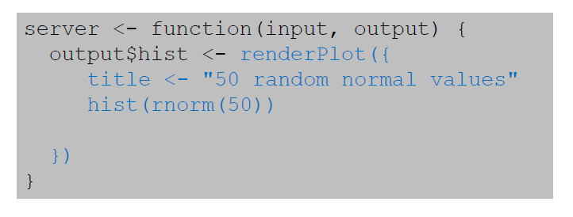
Server Function
Build objects to display with render*()

Slide 22
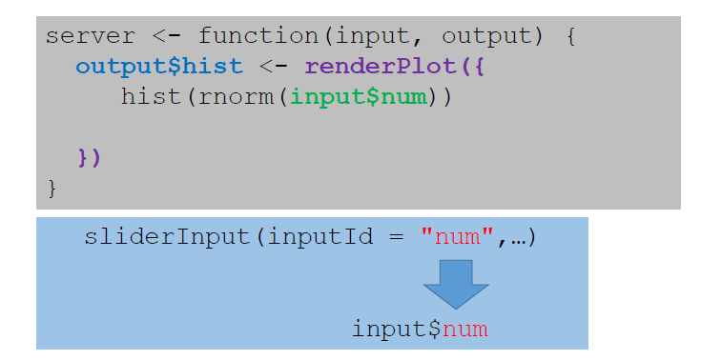
Server Function
Access input values with input$

Slide 23
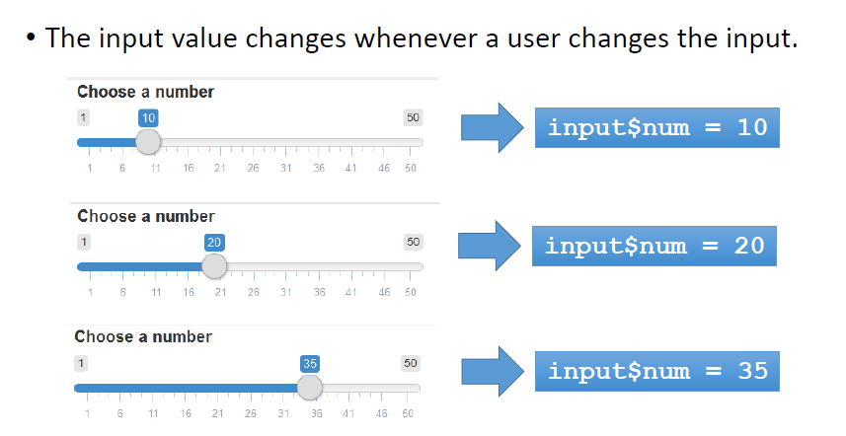
Input Values

Slide 24
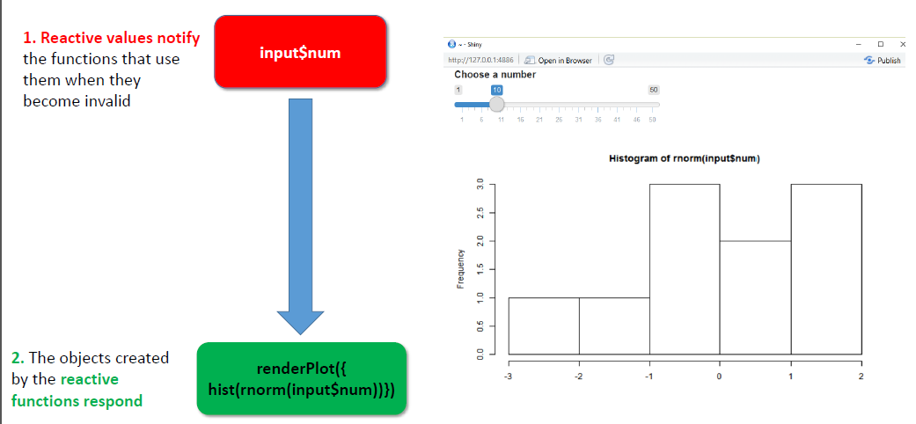
Reactivity in R as two steps process

Slide 25
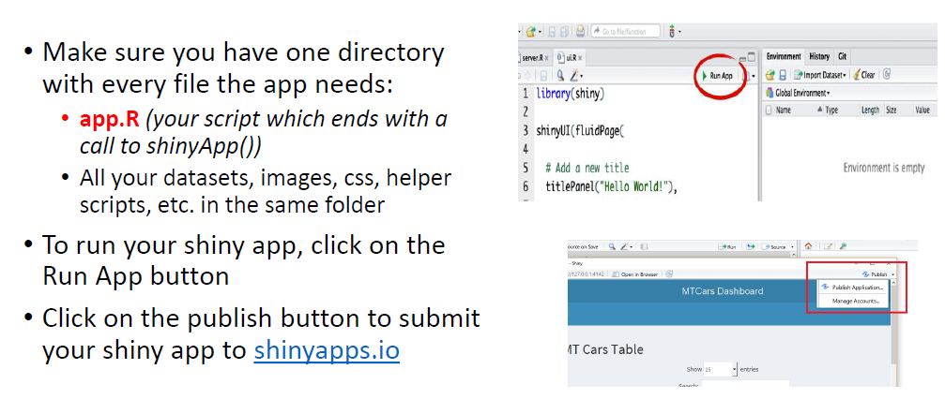
Running and Deploying apps

Slide 26
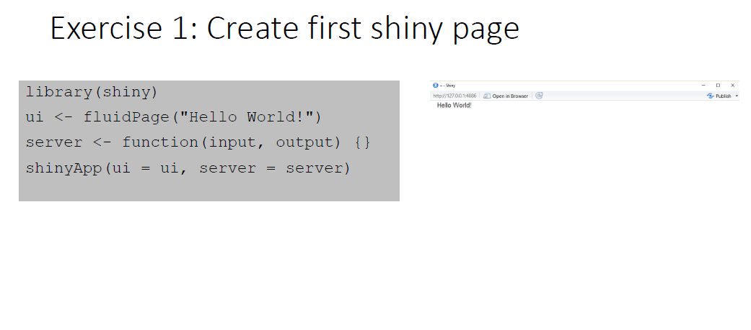

Slide 27
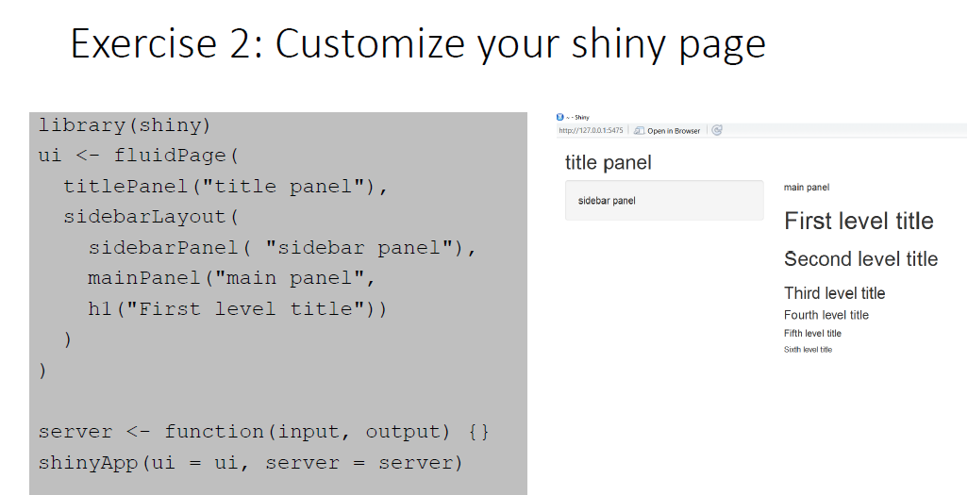

Slide 28
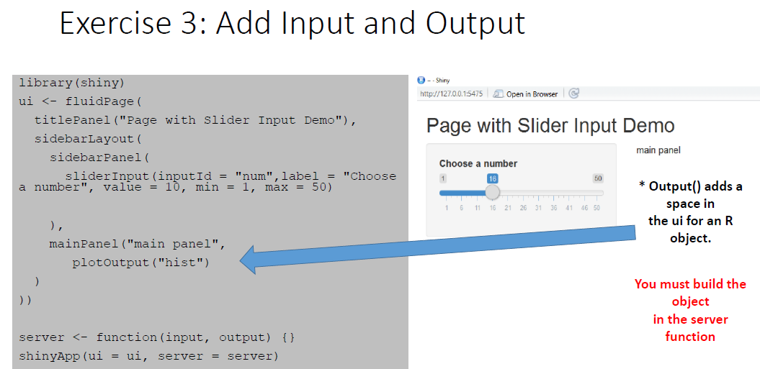

Slide 29
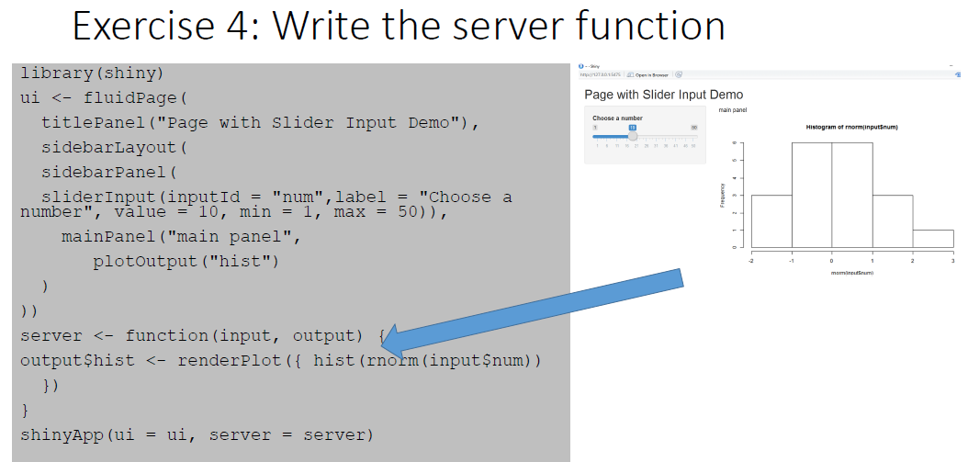

Slide 30
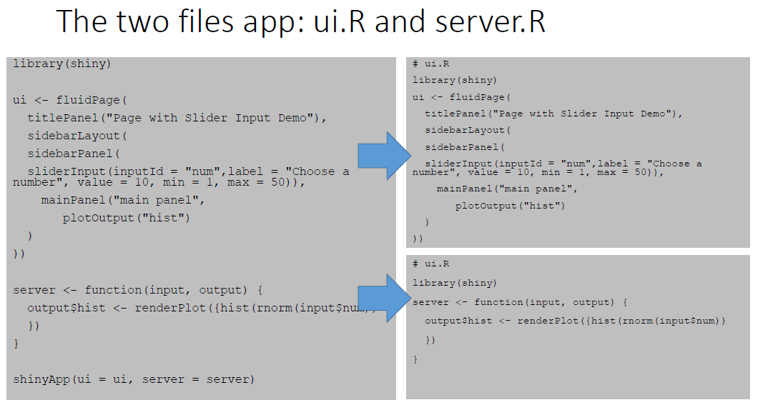

Slide 31
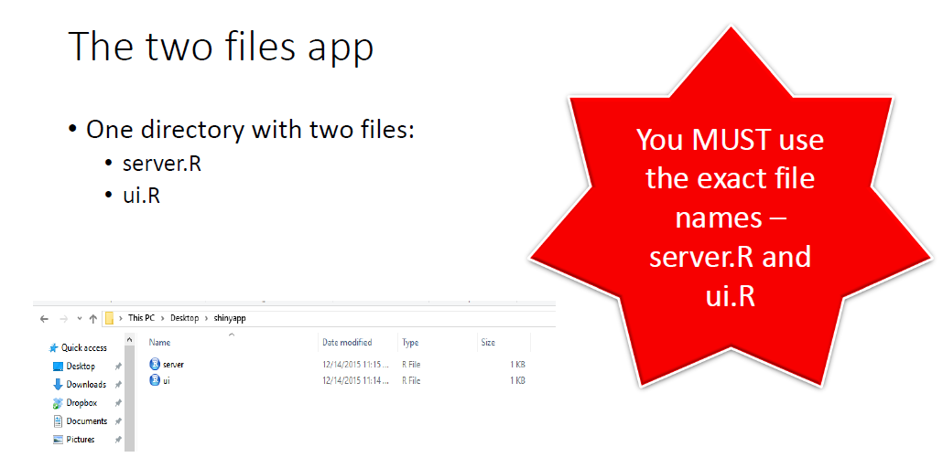

Slide 32
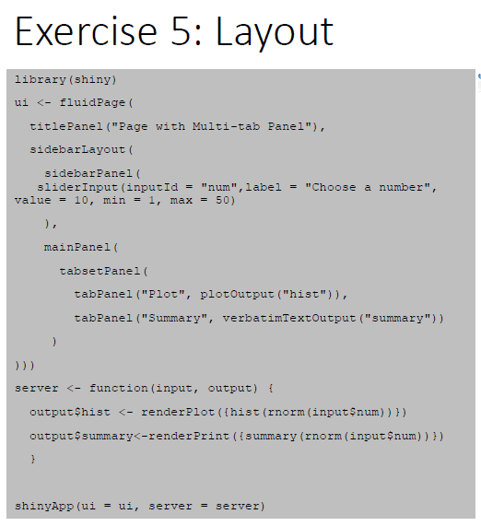
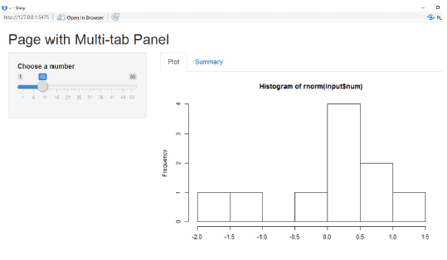

Slide 33
Assignment 2 – 10% Due: 14 May 2019
Write a shiny application.
The application must include the following:
Some form of input (widget: textbox, radio button, checkbox, ...)
Some operation on the ui input in sever.R
Some reactive output displayed as a result of server calculations

